Slide 1
IEEE ISIT 2022
On Finite-Time Mutual Information
Jieao Zhu, Zijian Zhang, Zhongzhichao Wan, and Linglong Dai
Dept. EE, Tsinghua University, Beijing, China
2022.6.26
Notes:
Good morning, everyone. I’m Jieao Zhu from the Department of Electronic Engineering at Tsinghua University. It’s my pleasure to introduce our work at the IEEE international symposium on information theory. The title of our work is “On Finite-Time Mutual Information”.

Slide 2
Outline
Introduction
Problem Formulation
An Insightful Case
Numerical Results
Conclusion
Notes:
We start with the introduction part.

Slide 3
Introduction
Shannon-Hartley[1] theorem
AWGN $W$-bandlimited channel, average/peak power constraint
Signal-to-noise ratio $γ$
DoF
bits/ch use
How to establish this theorem?
Slepian’s PSWF + Shannon’s random coding $→$ Achievability & Converse
Requirements: $T→∞$ limit operation
Finite-time case?
What if the assumption $T→∞$ is abandoned?
Notes:
The Shannon’s formula may be the most renowned formula in information theory. It states that for a continuous waveform channel bandlimited to W Hertz with the signal-to-noise ratio being γ, the highest possible information transmission rate is C=Wlog(1+γ) bits per second. In fact, this formula is the direct consequence of two results. First is the 2WT theorem [click], and the second is the channel capacity of a single-symbol Gaussian channel [click]. The establishment of the 2WT theorem is based on the so-called Slepian’s concentration problem, whose solution is the prolate spheroidal wave functions. Combined with Shannon’s random coding techniques, one can then prove the achievability and the converse of Shannon’s formula. However, note that in Slepian’s concentration problem, the degrees of freedom of a bandlimited channel is only studied in the asymptotic case where the observation time T->∞ [click]. In fact, this infinite observation time also ensures that the random coding techniques can work. As a result, one may wonder what about the finite-time case when the observation time is finite?

Slide 4
Introduction
Shannon-Hartley theorem in the finite-time cases
(1) Finite blocklength: limited number of channel uses
Channel coding in the finite blocklength regime
$P_{e}$ bounded away from zero
(2) Finite observation time + infinite number of channel uses?
Stochastic received signal $Y\left(t\right)$ observed at any $t∈\left[−\frac{T}{2},\frac{T}{2}\right]$
$I\left(X\left(t\right);Y\left(t\right)\right)$ on $\left[−\frac{T}{2},\frac{T}{2}\right]$: Mutual information between two stochastic processes (SPs)!
What’s the quantity $I\left(X\left(t\right);Y\left(t\right)\right)$? Finite? Infinite? Achievable?
What’s the relationship between this quantity and the Shannon-Hartley theorem?
What’s the properties of the MI between two SPs?
Notes:
In fact, there are two different understandings of the temporal finiteness. (1) The first understanding is to fix the channel sampling rate and impose restrictions on the number of observed channel outputs. Due to the finiteness of the codeword length, the probability of error cannot be made arbitrary close to zero. However, sampling the received finite-time waveform will definitely lose some information. So we adopt the second understanding here. (2) We abandon the idea of sampling and codeword length. We only restrict the observation time of a noisy stochastic process, and we try to evaluate how many bits we can obtain from that observation. And that can be interpreted as the mutual information between two stochastic processes in a finite-time window. The MI, or mutual information $I\left(X\left(t\right);Y\left(t\right)\right)$ is our research interest. We can ask questions about the finiteness, the achievability, and so on of that MI quantity. [click] But the first step is to evaluate this MI between two SPs.

Slide 5
Outline
Introduction
Problem Formulation
An Insightful Case
Numerical Results
Conclusion
Notes:
This is how we formulate this problem.

Slide 6
Problem Formulation
Signal models: continuous signal, finite-time observation
AWGN noise $N\left(t\right)$ of power spectral density $n_{0}/2$
WSS Gaussian process input $X\left(t\right)$, autocorrelation function $R_{X}\left(τ\right)$
What’s the mutual information between $X\left(t\right)$ and $Y\left(t\right)$ on $\left[−\frac{T}{2},\frac{T}{2}\right]$?
Observation Window
$$−T/2$$
$$T/2$$
$$I\left(X;Y\right)$$
$$X\left(t\right)$$
$$−T/2$$
$$T/2$$
$$Y\left(t\right)$$
$$X\left(t\right)|Y(\left[−T/2,T/2\right])$$
The mutual information: Reduction of uncertainty
Notes:
We consider an AWGN channel with noise power spectral density being n0/2. We further assume that the transmitted process is a wide-sense-stationary Gaussian process $X\left(t\right)$, with autocorrelation $R_{X}\left(τ\right)$. Our goal is to evaluate the mutual information between X(t) and Y(t) on $\left[−\frac{T}{2},\frac{T}{2}\right]$. Note that after observing Y(t) on the finite-time window, the posterior process X(t)|Y is immediately updated, and the MI is defined as the reduction of uncertainty [click] when obtaining this posterior process.

Slide 7
The Karhunen–Loève Expansion
For a square integrable process $X\left(t\right)$ with autocorrelation $R_{X}\left(t_{1},t_{2}\right)$:
where $λ_{k}↓0$, $\left\{φ_{k}\right\}$ orthonormal.
Process decomposition: $x_{k}$ independent
[2] R. Huang and R. Johnson, “Information capacity of time-continuous channels,” IRE Trans. Inf. Theory, vol. 8, no. 5, pp. 191-198, Sep. 1962.
Notes:
To analyze this MI problem on continuous-time Gaussian processes, we refer to reference [1] for basic mathematical tools. The K-L expansion is suitable in this case, since it can decompose a process into a sequence of independent random variables and a set of orthonormal bases.

Slide 8
The Karhunen–Loève Expansion
Channel decomposition using K-L expansion [2]
Original: $Y\left(t\right)=X\left(t\right)+N\left(t\right)$
Decomposed: $y_{k}=\sqrt{λ_{k}}x_{k}+n_{k}$
$x_{k}∼𝒩\left(0,1\right), n_{k}∼𝒩\left(0,n_{0}/2\right)$
Finite-time MI as an infinite series
[2] R. Huang and R. Johnson, “Information capacity of time-continuous channels,” IRE Trans. Inf. Theory, vol. 8, no. 5, pp. 191-198, Sep. 1962.
Notes:
This K-L expansion implies that we can convert the finite-time channel into an infinite number of independent Gaussian scalar sub-channels. Accordingly, the finite-time mutual information $I\left(T\right)$ is given by the infinite sum of the capacities of all the sub-channels. Note that the finite-time capacity is determined by the ratio of the eigenvalues and the noise power spectral density. However, this infinite series expression does not provide us with any insight about how the finite-time mutual information behaves. So we are going to provide an insightful special case.

Slide 9
Outline
Introduction
Problem Formulation
An Insightful Case
Numerical Results
Conclusion

Slide 10
An Insightful Special Case
Assumptions of the Special Case
Input distribution: $R_{X}\left(τ\right)=Pe^{−α\left|τ\right|}$
Typical output autocorrelation when passing a white process through a first-order RC filter
(1) Equation of the
eigen problem
$$ω_{k}^{2}$$
(2) The equivalent differential equation
(3) The resonant frequencies and the eigenvalues
Notes:
We assume the input autocorrelation of the process $X\left(t\right)$ is $R_{X}\left(τ\right)=Pe^{−α\left|τ\right|}$. It is a typical autocorrelation because it is the output distribution of a first-order RC filter, when fed with a white process. Then, we obtain the eigen equation, the equivalent differential equation, and the solutions here. After these mathematical steps, we obtain the eigenvalues $λ_{k}$.

Slide 11
An Insightful Special Case
The finite-time mutual information $I\left(T\right)$
Input distribution: $R_{X}\left(τ\right)=Pe^{−α\left|τ\right|}$
Evaluation steps:
Determine $ω_{k}$ from
Calculate $λ_{k}=\frac{2αP}{α^{2}+ω_{k}^{2}}$
Evaluate $I(T)$ by the infinite series expression
Baseline: Shannon-Hartley theorem for arbitrary signal PSD [6]
Average number of bits per second $C_{av} [bps]$
Notes:
After obtaining the eigenvalues $λ_{k}$, we can numerically evaluate the finite-time mutual information, and compare the results with the predictions given by the Shannon-Hartley theorem. The Shannon’s capacity is also evaluated here explicitly under this channel model and input distribution.

Slide 12
Outline
Introduction
Problem Formulation
An Insightful Case
Numerical Results
Conclusion

Slide 13
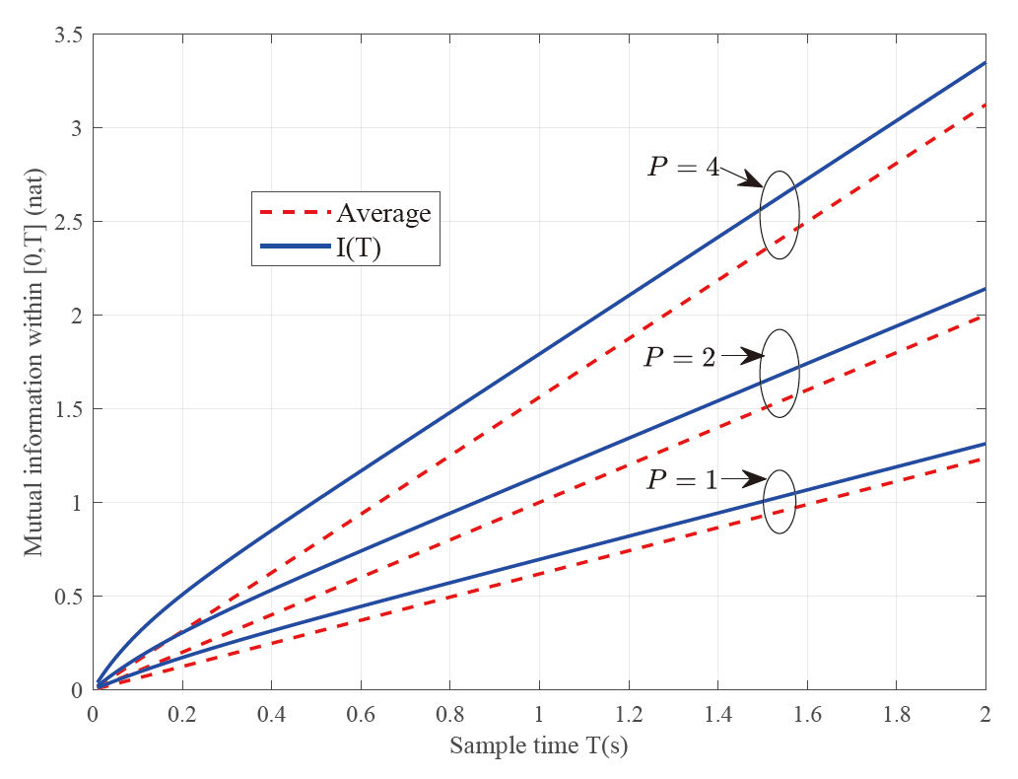
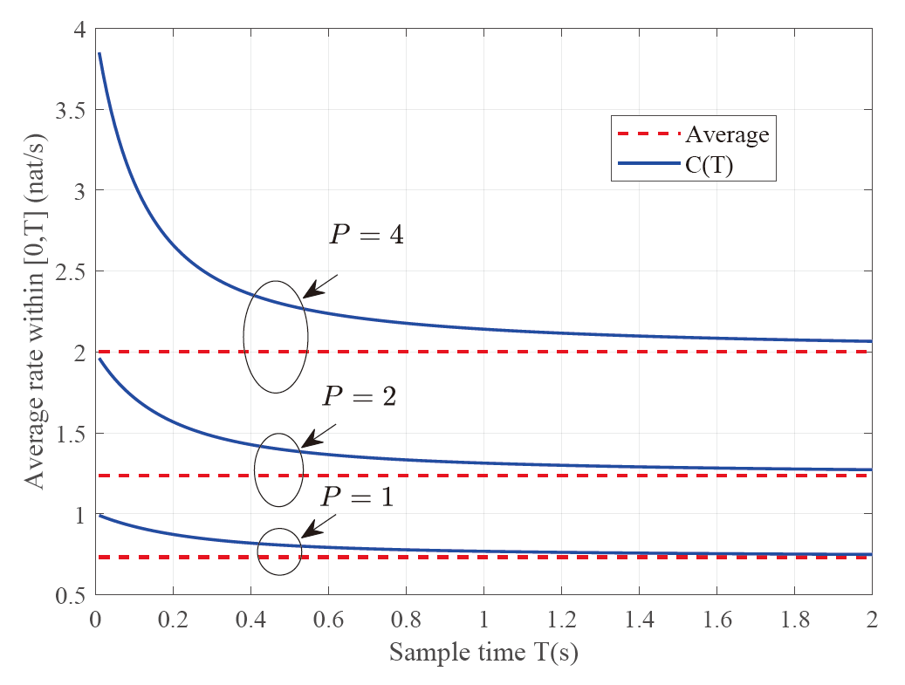
Numerical Results
The finite-time mutual information $I\left(T\right)$
Input distribution: $R_{X}\left(τ\right)=Pe^{−α\left|τ\right|}$
Numerical evaluation of $I\left(T\right)$ and $C\left(T\right)≔I(T)/T$
The finite-time MI exceeds the average MI given by Shannon’s formula?
Notes:
By numerical experiments, we find that the finite-time mutual information exceeds the average mutual information per second given by the Shannon’s formula [click] . The horizontal axis is the observation time T, and the vertical axis represents the mutual information in nats (left), and the information rate in nats per second (right).

Slide 14
Numerical Results & Discussions
The finite-time mutual information $I\left(T\right)$
Input distribution: $R_{X}\left(τ\right)=Pe^{−α\left|τ\right|}$
“Exceed-Average” phenomenon
Facts: $I\left(T\right)>TC_{av}$ numerically
Discussions
Shannon-Hartley theorem overthrown? No.
Because the time axis $≠$ independent copies of disjoint finite-time intervals
Besides, $I\left(T\right)>TC_{av}$ needs a rigorous proof
Explicit formula for $I\left(T\right)$?
Notes:
To sum up, we discovered the “exceed-average” phenomenon numerically. One may ask that does it mean that either our calculation is questionable, or the Shannon-Hartley theorem is overthrown? The answer is no. Because the Shannon-Hartley theorem takes the average of the whole time axis, which is not equivalent to independent copies of disjoint finite-time intervals in our case. Gaussian processes are not Markovian, and it has long-term correlation encoded in its autocorrelation function. As a result, observations of the same process on disjoint intervals are dependent.
But the “exceed-average” phenomenon is something new, which deserves a rigorous proof.

Slide 15
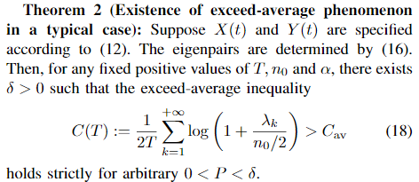
Numerical Results & Discussions
The proof of “Exceed-Average” phenomenon
Proofs are provided in our conference paper
$$λ_{k}=\frac{2αP}{α^{2}+ω_{k}^{2}}$$
Operator formulation
Treat $R_{X}\left(t_{1},t_{2}\right)$ as a trace-class operator $M:ℒ^{2}\left[−\frac{T}{2},\frac{T}{2}\right]→ℒ^{2}\left[−\frac{T}{2},\frac{T}{2}\right]$
$Tr\left(M\right)=PT<∞→I\left(T\right)<∞$
Notes:
We provide the proof of {Theorem 2} in our conference paper. It states that for sufficiently small transmission power, the “exceed-average” phenomenon is correct. During the proof, we treat the autocorrelation function as a trace-class operator M. The finiteness of the trace implies the finiteness of the finite-time mutual information.

Slide 16
Proof Sketch
Proof sketch of Theorem 2, to prove the inequality, we
Take the derivative w.r.t. $P$
Use the finiteness of the operator trace $Tr\left(M\right)=PT$, and convert the original inequality into another form related to $Tr\left(M^{2}\right)$
Evaluate $Tr\left(M^{2}\right)$ explicitly, and it leads to the conclusion directly
Achievability & Converse bounds
Open questions. $I\left(T\right)$ needs to be maximized to obtain the capacity.
Globally bandlimited to $W$, observations restricted to $\left[−\frac{T}{2},\frac{T}{2}\right]$.
A useful orthonormal bases: PSWF.
Notes:
The proof sketch is provided here, and the achievability and converse theorems about the finite-time mutual information are still open questions. A possible way is to resort to the PSWF established in Slepian’s concentration problems.

Slide 17
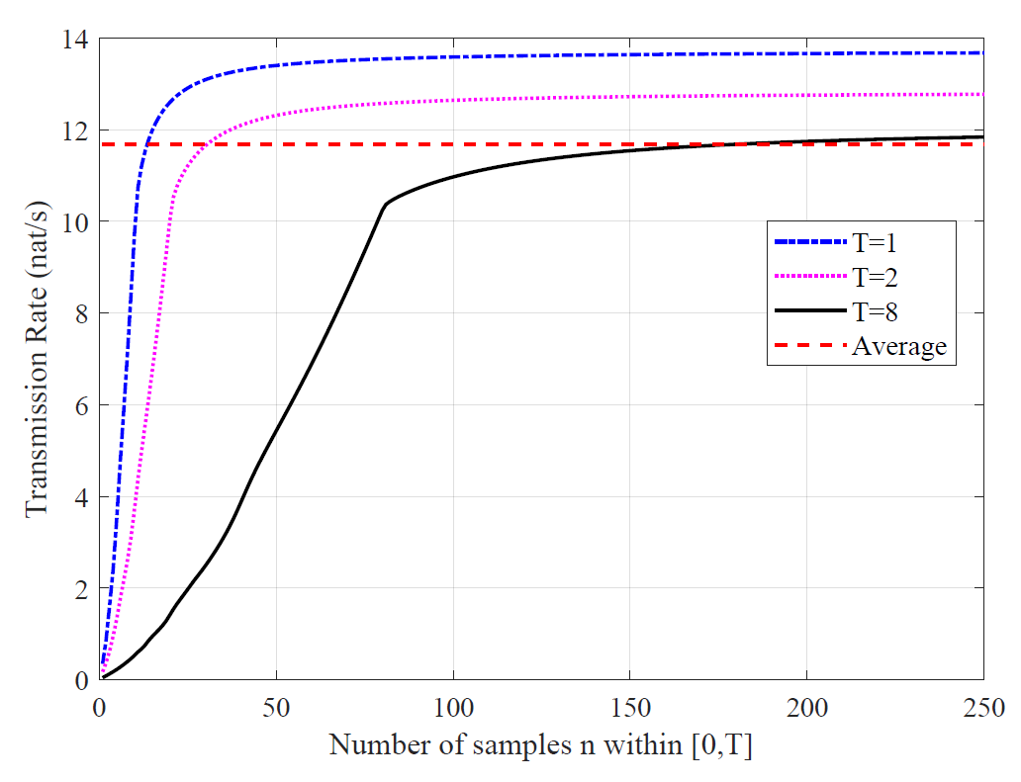
Numerical Results & Discussions
Beyond the special case $R_{X}\left(τ\right)=Pe^{−α\left|τ\right|}$: Another case
$R_{X}\left(τ\right)=sinc\left(10τ\right)$
$R_{N}\left(τ\right)=exp\left(−τ\right)$
Finite-time MI
$$C_{av}$$
Approximated by discretization over the time axis
The “Exceed-Average” may be a general property. Future works needed.
Notes:
Here we use another couple of signal and noise autocorrelation functions to numerically evaluate the finite-time mutual information. The orthonormal bases are approximated by sampling over the time axis. We assume that as the number of samples tends to infinity, the mutual information on these samples would finally tend to the finite-time mutual information. In this different case, the “exceed-average” phenomenon occurs again. So we believe that it is a general property. [click] Future works are needed here.

Slide 18
Conclusion
Motivation
Shannon-Hartley theorem deals with the case $T→∞$
The evaluation of finite-time MI between two processes is generally unknown
Methods
KL expansion and operator characterization of stochastic processes
Numerical evaluations of the finite-time MI, based on a special case
Results
Proof of “exceed-average” by operator spectral theory
Maybe useful when analyzing finite-time OFDM blocks
Notes:
Here is the conclusion. Motivated by the observation that the Shannon-Hartley theorem deals with infinite time case, we start to wonder what is the finite-time mutual information between two processes. Following existing works, we use the KL expansion to decompose the processes into independent components. Using operator theory and some equation-solving techniques, we solve the eigen differential equations of a special case, and numerically evaluated the finite-time mutual information. From the numerical results we discovered the “exceed-average” phenomenon, and proved it by operator spectral theory. [click] The finite-time mutual information maybe useful when analyzing the information-theoretic performance of consecutive finite-time OFDM blocks.

Slide 19
References
[1] C. E. Shannon, “A mathematical theory of communication,” The Bell Syst. Techni. J., vol. 27, no. 3, pp. 379-423, Jul. 1948.
[2] R. Huang and R. Johnson, “Information capacity of time-continuous channels,” IRE Trans. Inf. Theory, vol. 8, no. 5, pp. 191-198, Sep. 1962.
[3] H. Landau, “Sampling, data transmission, and the Nyquist rate,” Proc. IEEE, vol. 55, no. 10, pp. 1701-1706, Oct. 1967.
[4] H. Nyquist, “Certain topics in telegraph transmission theory,” Trans. American Institute of Electrical Engineers, vol. 47, no. 2, pp. 617-644, Apr. 1928.
[5] D. Slepian, “On bandwidth,” Proc. IEEE, vol. 64, no. 3, pp. 292-300, Mar. 1976.
[6] T. M. Cover, Elements of information theory. John Wiley & Sons, 1999.
[7] J. Mercer, “Functions of positive and negative type and their connections with the theory of integral equations,” Philos. Trans. Royal Soc., vol. 209, pp. 4-415, 1909.
[8] A. Balakrishnan, “A note on the sampling principle for continuous signals,” IRE Trans. Inf. Theory, vol. 3, no. 2, pp. 143-146, Jun. 1957.
[9] J. Barrett and D. Lampard, “An expansion for some second-order probability distributions and its applications to noise problems,” IRE Trans. Inf. Theory, vol. 1, no. 1, pp. 10-15, Mar. 1955.
[10] D. Cai and P. S. Vassilevski, “Eigenvalue problems for exponential-type kernels,” Comput. Methods in Applied Maths, vol. 20, no. 1, pp. 61-78, Jan. 2020.
Notes:
This is our references.

Slide 20
IEEE ISIT 2022
Thanks!
For more information:
http://oa.ee.tsinghua.edu.cn/dailinglong/publications/publications.html
Notes:
That’s the end of this presentation. Thank you for your attention!

